Slide 1
Finding the equation of the line y = mx + c
Graphical representations of linear equations

Slide 2
how to use Oak lessons

Slide 3
I can find the equation of the line in the form y = mx + c

Slide 4
An equation of a line is any equation whose graph forms a straight line.
The gradient is a measure of how steep a line is. It is calculated by finding the rate of change in the y-direction with respect to the positive x-direction.
An intercept is the coordinate where a line or curve meets a given axis.

Slide 5

Finding the equation of the line y = mx + c
Writing the equation of a line from key features
Finding the equation of a line

Slide 6
Writing the equation of a line from key features
Equations of straight lines can be written in a variety of ways.
Any equation representing a linear relationship between x and y values will form a linear graph when plotted.
When an equation of a line is written in the form y = mx + c the gradient and y-intercept are easy to identify.
y = mx + c
The coefficient of x (m) is the gradient of the line.
The constant (c) is the y-intercept.

Slide 7
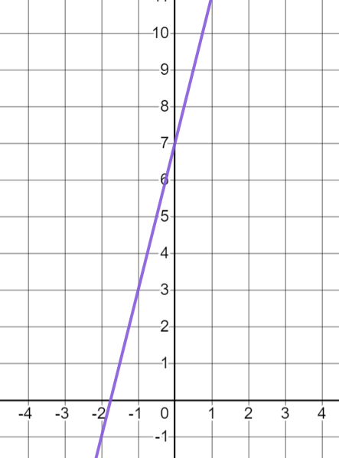
Writing the equation of a line from key features
This means, if we know the gradient and y-intercept, we can write an equation for the line.
For example: This line has a gradient of 4 and a y-intercept of (0, 7)
An equation for this line is y = 4x + 7
Can we draw a different line with gradient 4 and y-intercept 7?
No, this graph is uniquely described by its gradient and y-intercept.

Slide 8
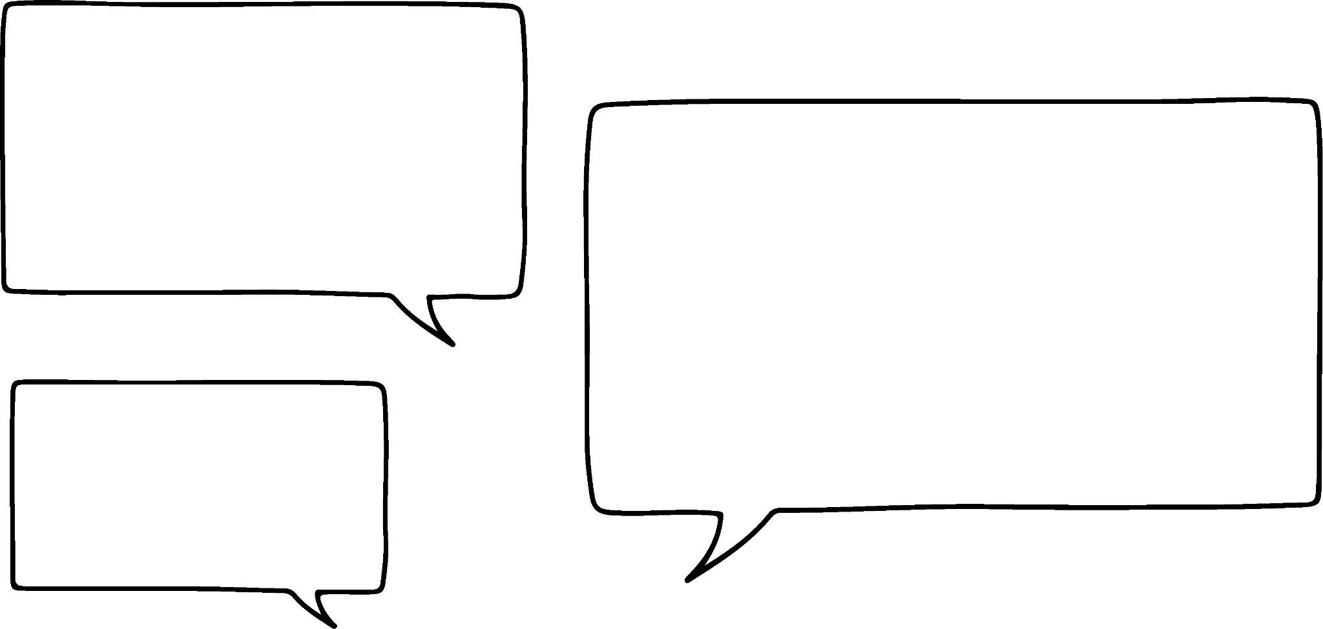




Writing the equation of a line from key features
Lucas has drawn a line with y-intercept (0, 5) and gradient −2
The equation is
y = −2x + 5
The equation is y = 5x −2
The equation is y = 5 + 2x
The equation is
y = 5 − 2x
Sam
Sofia
Alex
Izzy
Who is correct?
Sam and Izzy. The y-intercept is the constant and the coefficient of x is the gradient.

Slide 9
Writing the equation of a line from key features
Write the equation for the line which has these features:
Gradient 5 and y-intercept (0, −4)
y = 5x − 4 or y = −4 + 5x
Gradient −1 and y-intercept (0, 3)
y = −x + 3 or y = 3 − x
Gradient −4 and y-intercept (0, 0)
y = −4x + 0 or y = −4x

Slide 10
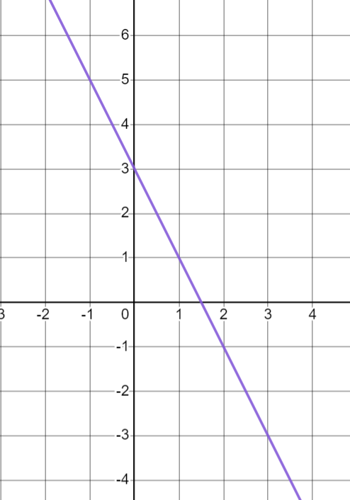
Writing the equation of a line from key features
We can work out the equation of a line from its graph.
We need to calculate the gradient and find y-intercept.
+1
The gradient is −2
−2
The y-intercept is (0, 3)
The equation of the line is y = −2x + 3 or y = 3 − 2x

Slide 11
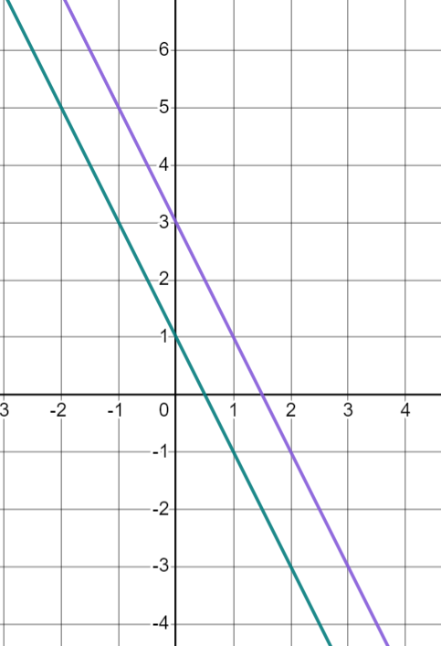
Writing the equation of a line from key features
If the purple graph (A) is y = −2x + 3 what is the equation of the green graph (B)?
A
How do you know?
y = −2x + 1 or y = 1 − 2x
B
The gradient is the same as A because they are parallel. The y-intercept is (0, 1).
The green graph (B) is a translation of the purple graph (A). It has moved down 2.

Slide 12
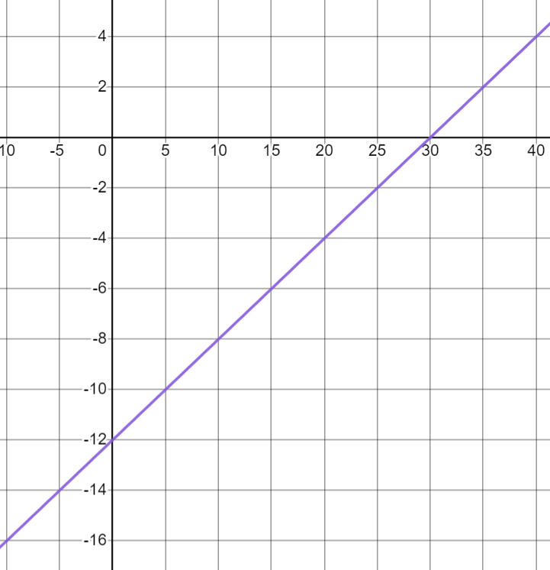
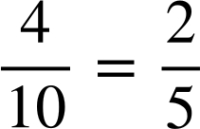

Writing the equation of a line from key features
We need to be careful to check the scales when reading graphs.
What is the equation of this line?
Using ratio tables can help us calculate gradient accurately.
Change in x | Change in y
10 | 4
1
The y-intercept is (0, −12)
+4
+10
The equation of the line is y = x − 12

Slide 13
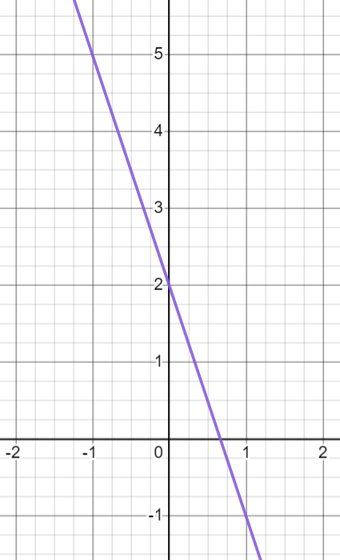

Writing the equation of a line from key features
This line has the equation y = 3x + 2
The gradient is negative.
The y-intercept is negative.

Slide 14
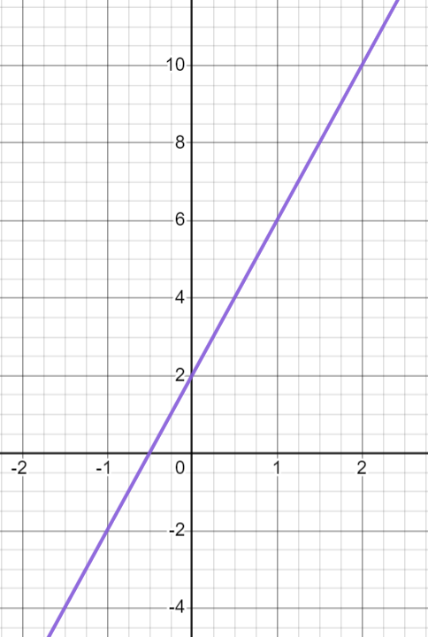
Writing the equation of a line from key features
This line has the equation y = 4x + 2
The y-intercept is 2 and the gradient is 4
The y-intercept is 4 and the gradient is 2

Slide 15
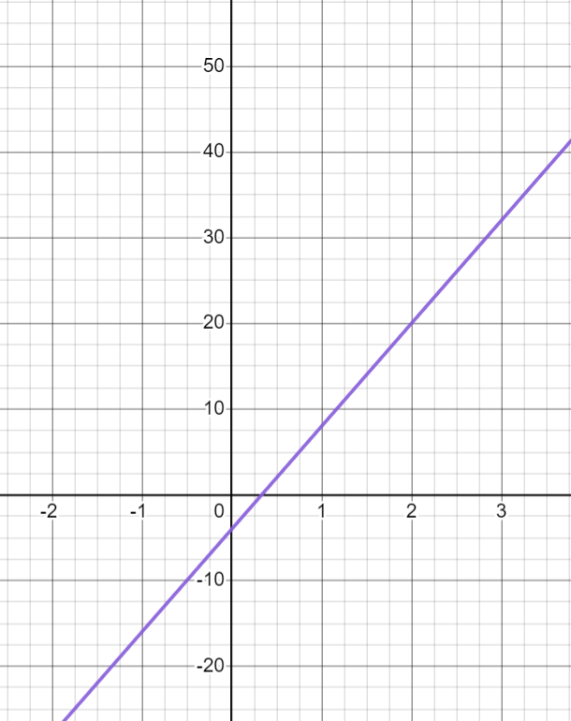
Writing the equation of a line from key features
This line has the equation y = 12x + 2
The gradient is less than 12
The y-intercept should be negative.

Slide 16
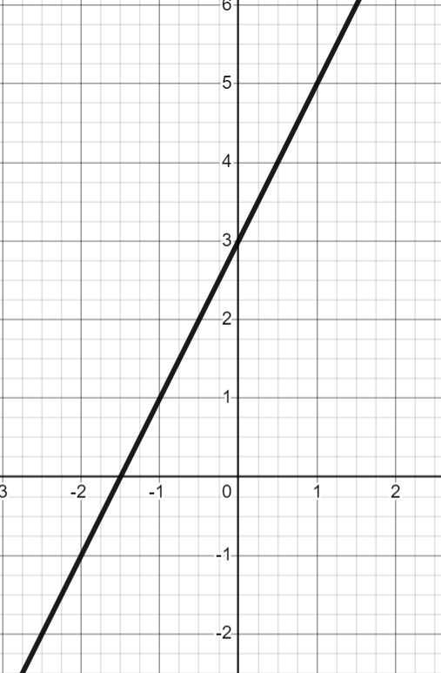
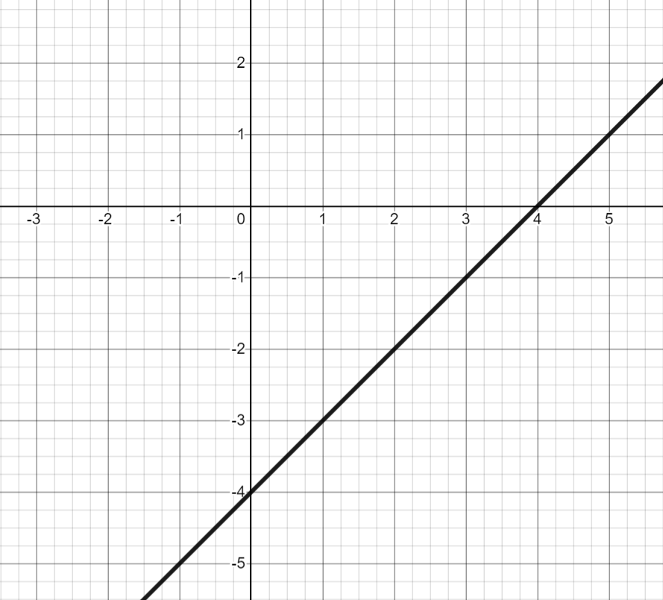
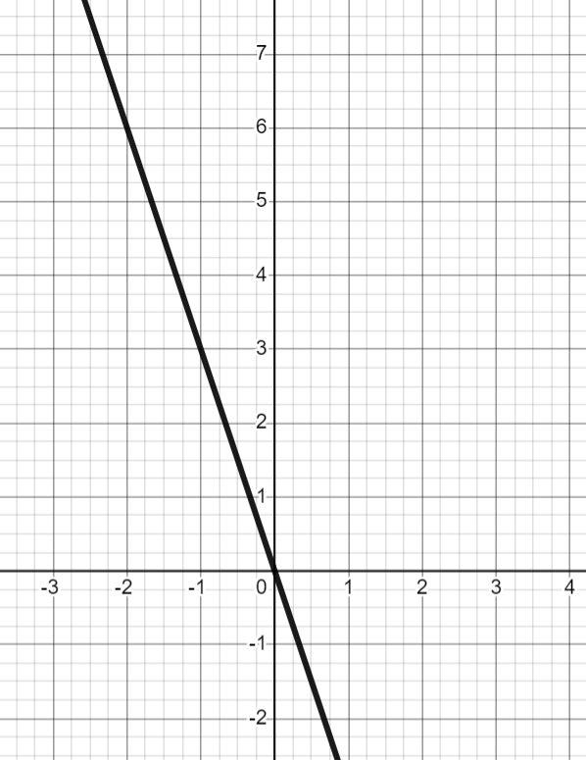
Writing the equation of a line from key features
For each graph, work out an equation for the line in the form y = mx + c
 | b) | c)
gradient:.
y-intercept:
equation:
gradient:
y-intercept:
equation:.
gradient:.
y-intercept:.
equation:.

Slide 17
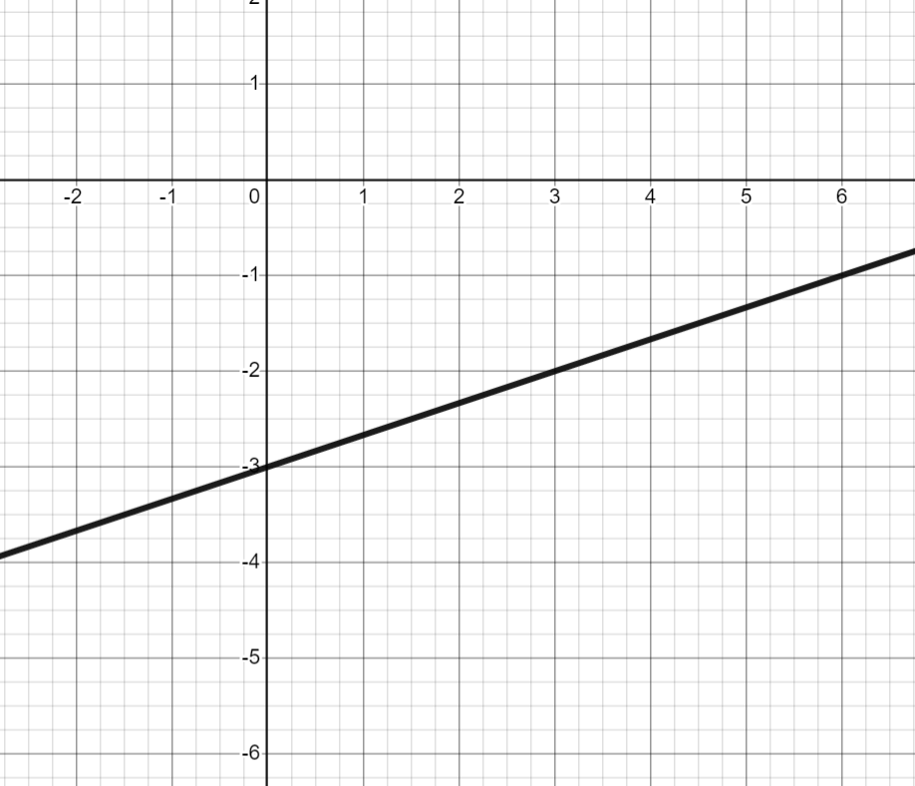
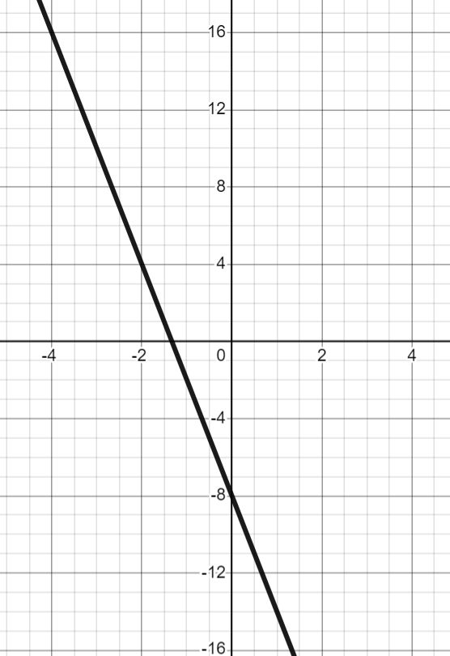
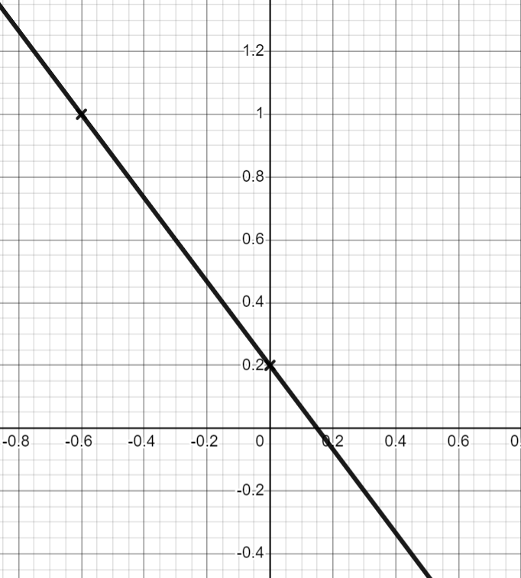
Writing the equation of a line from key features
For each graph, work out an equation for the line in the form y = mx + c
d) | e) | f)
gradient:
y-intercept:
equation:
gradient:
y-intercept:
equation:
gradient:
y-intercept:.
equation:.

Slide 18
Writing the equation of a line from key features
For each graph, work out an equation for the line in the form y = mx + c
 | b) | c)
gradient: 2
y-intercept: (0, 3)
equation: y = 2x + 3
gradient: 1
y-intercept: (0, −4)
equation: y = x − 4
gradient: −3
y-intercept: (0, 0)
equation: y = −3x

Slide 19


Writing the equation of a line from key features
For each graph, work out an equation for the line in the form y = mx + c
d) | e) | f)
gradient:
y-intercept: (0, −3)
equation: y = x − 3
gradient: −6
y-intercept: (0, −8)
equation: y = −6x − 8
gradient:
y-intercept: (0, 0.2)
equation: y = x + 0.2

Slide 20
Finding the equation of the line y = mx + c
Writing the equation of a line from key features
Finding the equation of a line

Slide 21

Finding the equation of a line
We can calculate the equation of a line from its table of values.
+1
x | −1 | 0 | 1
y | −8 | −4 | 0
When x increases by 1, y increases by 4
The gradient of the line is 4
+4
The y-intercept is (0, −4)
The equation of the line could be written as y = 4x − 4

Slide 22
Finding the equation of a line
If we do not know the y-intercept, we can calculate it from the gradient.
+1
x | 1 | 2 | 3
y | 12 | 10 | 8
The gradient of the line is −2
−2
x | 0 | 1 | 2 | 3
y |  | 12 | 10 | 8
The y-intercept is (0, 14)
14
+2
The equation of the line could be written as y = −2x + 14

Slide 23
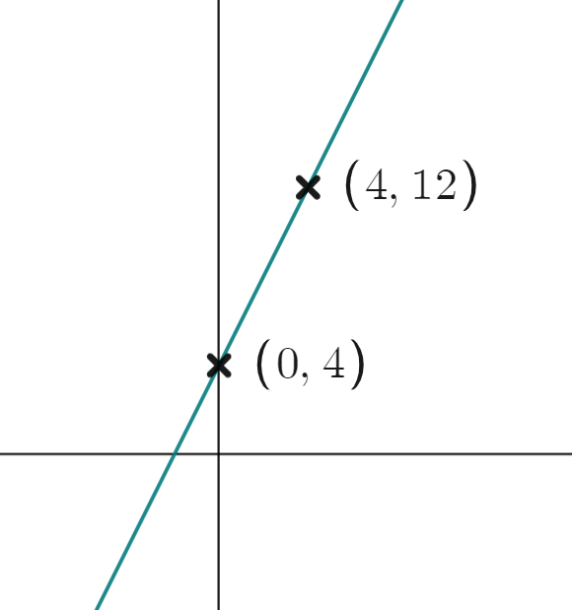
Finding the equation of a line
We can calculate the equation of a line if we know the y-intercept and another coordinate.
Change in x | Change in y
4
8
1
2
The gradient is 2
The y-intercept is (0, 4)
The equation of the line could be written as y = 2x + 4

Slide 24
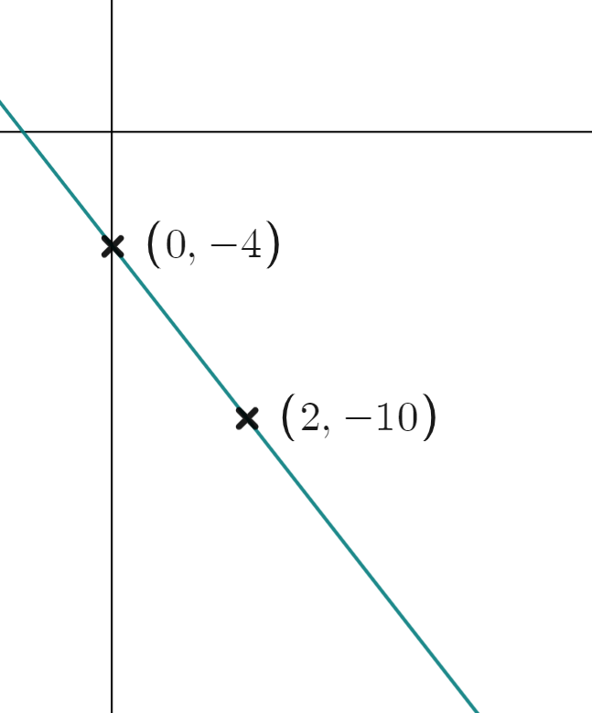
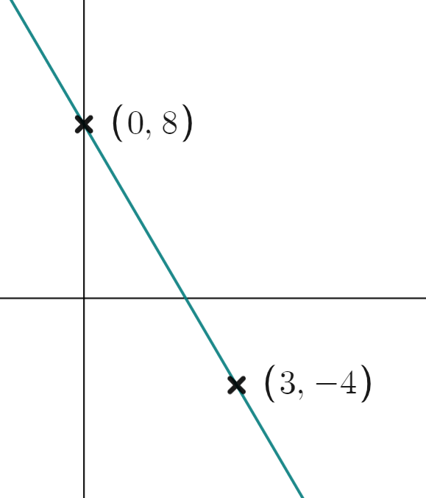
Finding the equation of a line
Calculate the equation of this line.
Calculate the equation of this line.
Change in x | Change in y
Change in x | Change in y
3
−12
2
−6
1
−4
1
−3
The gradient is −4
The gradient is −3
The y-intercept is (0, 8)
The y-intercept is (0, −4)
The equation of the line could be written as y = −4x + 8
The equation of the line could be written as y = −3x − 4

Slide 25
Finding the equation of a line
We can calculate the equation of a line if we know any two coordinates on the line.
What is the equation of the line which passes through (3, 5) and (12, 14)?
Remember that the equation of the line shows a relationship between the x and y values in a coordinate pair.
Can you spot a relationship which is true for both coordinates?
y = x + 2

Slide 26
Finding the equation of a line
Can you spot the relationship between the x and y coordinates for each these coordinates?
y = 2x
(3, 6) and (5, 10)
y = x
(8, 8) and (15, 15)
y = x − 3
(7, 4) and (2, −1)

Slide 27
Finding the equation of a line
Most of the time it will be too tricky to spot the relationship from 2 coordinates.
Instead we can find the gradient and y-intercept and work the equation out from them.
We can then check the relationship holds true for both coordinates.

Slide 28
Finding the equation of a line
Lets calculate the equation of the line joining (3, 4) and (5, 8)
+2
+4
Remember that when just given coordinates, a sketch of the two coordinates can help you to check if the gradient is positive or negative.
Change in x | Change in y
2 | 4
(3, 4)
(5, 8)
gradient = 2
1
2
2 × 3 = 6
x | 0 | ….. | 3 | ….. | 5
y |  | ….. | 4 | ….. | 8
−2
4 − 6 = −2
−6
+2
The equation of the line could be written as y = 2x − 2

Slide 29
Finding the equation of a line
The equation of the line could be written as y = 2x −2
Now we check this relationship works for the coordinates (3, 4) and (5, 8)
Substitute the x value into the right hand side of the equation and see if it equals the y value (3, 4) and (5, 8)
2 (3) − 2
2 (5) − 2
6 − 2
10 − 2
= 4
= 8
So (3, 4) is on the line y = 2x − 2
So (5, 8) is on the line y = 2x − 2

Slide 30
Finding the equation of a line
Calculate the equation of the line which goes through (5, 4) and (9, −16)
Calculate the equation of the line which goes through (4, −3) and (6, 17)
Change in x | Change in y
Change in x | Change in y
4
−20
2
20
1
−5
1
10
The gradient is −5
The gradient is 10
x | 0 | ….. | 5 | ….. | 9
y |  | ….. | 4 | ….. | −16
x | 0 | ….. | 4 | ….. | 6
y |  | ….. | −3 | ….. | 17
29
−43
+25
−5
+10
−40
The y-intercept is (0, 29)
The y-intercept is (0, −43)
Equation of the line: y = −5x + 29
Equation of the line: y = 10x − 43

Slide 31
Finding the equation of a line
Check if the coordinates (5, 4) and (9, −16) are on the line y = −5x + 29
Check if the coordinates (4, −3) and (6, 17) are on the line y = 10x − 43
−5 (5) + 29
10 (4) − 43
−25 + 29
40 − 43
= 4
= −3
So (5, 4) is on the line y = −5x + 29
(4, −3) is on the line y = 10x − 43
−5 (9) + 29
10 (6) − 43
−45 + 29
60 − 43
= −16
= 17
So (9, −16) is on the line y = −5x + 29
(6, 17) is on the line y = 10x − 43

Slide 32
Finding the equation of a line
Calculate the equation of the line which has the table of values shown.
a)
b)
c)
d)
x | 0 | 1 | 2
y | −7 | −3 | 1
x | −1 | 0 | 1
y | 14 | 3 | −8
x | ….. | 1 | 2 | 3
y | ….. | 5 | 3 | 1
x | ….. | 10 | 11 | 12
y | ….. | −12 | −11 | −10

Slide 33
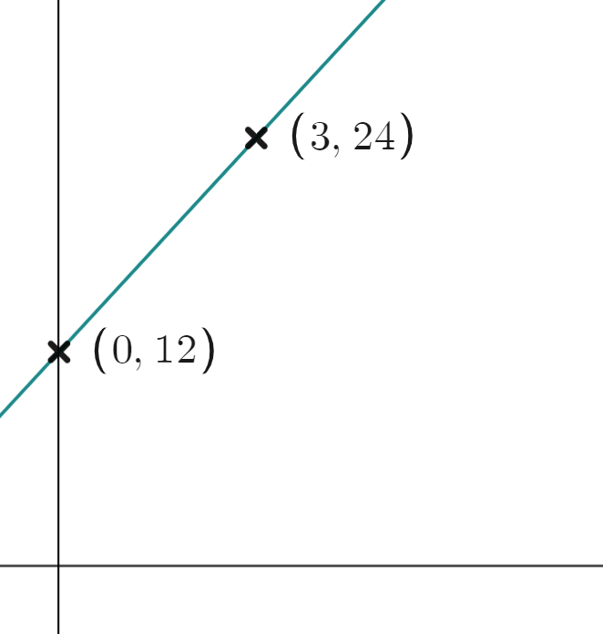
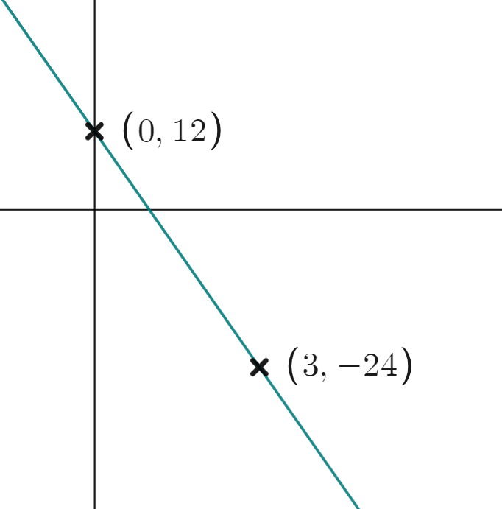
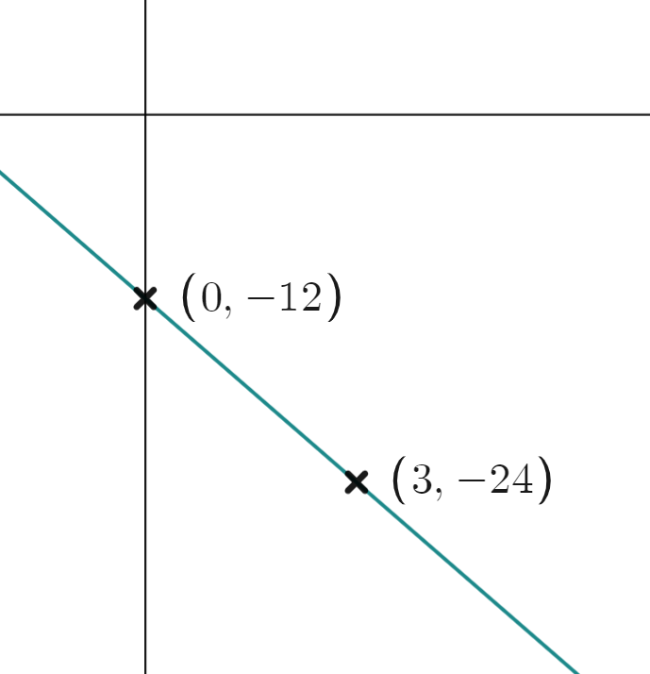
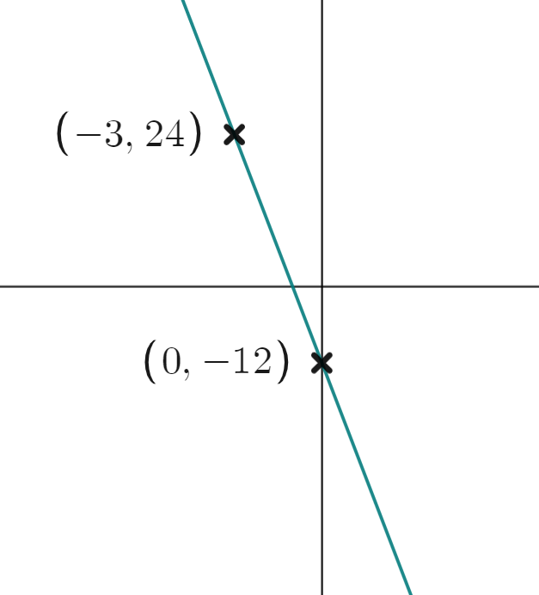
Finding the equation of a line
2) Calculate the equation of each line.
a) | b) | c) | d)

Slide 34
Finding the equation of a line
3) Calculate the equation of the line passing through the coordinates given
a) (3,5) and (5,13) | b) (3,5) and (7,−9) | c) (3,5) and (−2,0) | d) (3,5) and (−15,−1)
Change x | Change y
Change x | Change y
Change x | Change y
x | 0 … | 3 … | 5
y | … | 5 … | 13
x | 0 … | 3 … | 7
y | … | 5 … | −9
x
y
Equation:
Equation:
Equation:
Equation:

Slide 35
Finding the equation of a line
Calculate the equation of the line which has the table of values shown.
a)
b)
c)
d)
x | 0 | 1 | 2
y | −7 | −3 | 1
y = 4x −7
x | −1 | 0 | 1
y | 14 | 3 | −8
y = −11x + 3
x | 0 ….. | 1 | 2 | 3
y | 7 ….. | 5 | 3 | 1
y = −2x + 7
x | 0 ….. | 10 | 11 | 12
y | −22 …. | −12 | −11 | −10
y = x − 22

Slide 36
Finding the equation of a line
2) Calculate the equation of each line.
a) | b) | c) | d)
Change x | Change y
3 | 12
1 | 4
Change x | Change y
3 | −36
1 | −12
Change x | Change y
3 | −12
1 | −4
Change x | Change y
3 | −36
1 | −12
y = 4x + 12
y = −12x + 12
y = −4x − 12
y = −12x − 12

Slide 37
Finding the equation of a line
3) Calculate the equation of the line passing through the coordinates given
a) (3,5) and (5,13) | b) (3,5) and (7,−9) | c) (3,5) and (−2,0) | d) (3,5) and (−15,−1)
18 | 6
1
Change x | Change y
2 | 8
1 | 4
Change x | Change y
4 | −20
1 | −5
Change x | Change y
5 | −5
1 | −1
Gradient = 4
Gradient = −5
Gradient = −1
Gradient =
x | 0 … | 3 … | 5
y | −7 | 5 … | 13
x | 0… | 3 … | 7
y | 20 | 5 … | −9
x | 0 | … | 3
y | 8 | … | 5
x | 0 | … | 3
y | 4 | … | 5
Equation:
y = 4x − 7
Equation:
y = −5x + 20
Equation:
y = −x + 8
Equation:
y = x + 4

Slide 38
Finding the equation of the line y = mx + c
We can write the equation of a line in the form y = mx + c when we are given the gradient and y-intercept.
We can write the equation of any line given the graph of the line.
We can write the equation of any line given a table of values for that line.
We can write the equation of any line given any two coordinates on the line.

Slide 39

© Oak National Academy 2023.
Produced in partnership with Mathematics in Education and Industry.
Licensed on the Open Government Licence v3.0, except where otherwise stated. See Oak terms and conditions.

